Slide 1





FLIGHT DELAY PREDICTION MODEL
Presented by: Rowida Elsayed

Slide 2

INTRODUCTION
Predicting flight delays due to weather for a travel booking website aims to notify customers about potential flight delays.
Dataset Overview:
Source: U.S. Office of Airline Information, Bureau of Transportation Statistics (BTS).
Data Period: 2013-2018.
Features: Date, time, origin, destination, airline, distance, delay status

Slide 3
DATA PREPROCESSING AND EDA
Download and extract data from .zip files.
Load data into pandas DataFrame.
Explore dataset: shape, columns, basic statistics.
Visualize data distributions.
Exploratory Data Analysis (EDA) Considered:
What do basic statistics reveal about features?
What are the distributions of target classes?

Slide 4
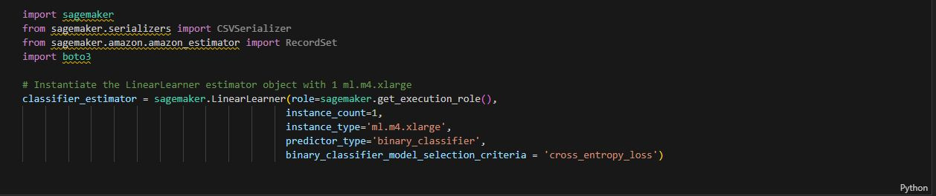
MACHINE LEARNING MODEL
Use Amazon SageMaker for scalable model training.
Instantiate the LinearLearner estimator for binary classification.
Role: Specifies the IAM role that SageMaker can assume to perform tasks.
Instance Count: Number of instances to use for training.
Instance Type: Type of instance to use (e.g., ml.m4.xlarge).
Predictor Type: Specifies the type of prediction (binary classification).
Model Selection Criteria: Criteria for selecting the best model ( cross-entropy loss).

Slide 5
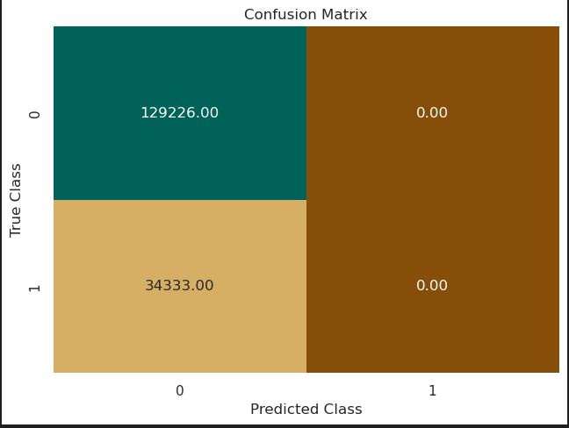
EVALUATE MODEL PERFORMANCE BY VISUALIZING THE CONFUSION MATRIX

Slide 6
FEATURE ENGINEERING
Improve model performance by refining the dataset
Identify if flights on holidays have different delay patterns.
Import weather data for relevant airports.
Merge weather data with flight data.
Prepare data for model training by encoding categorical variables.
Select relevant features for the model.
Categorical Variables: Converted to category type for efficient memory usage.
Dummy Variables: Created to represent categorical features as binary columns.
Concatenation: Combined dummy variables with the original dataset.
Dropping Original Columns: Removed original categorical columns to avoid redundancy.

Slide 7
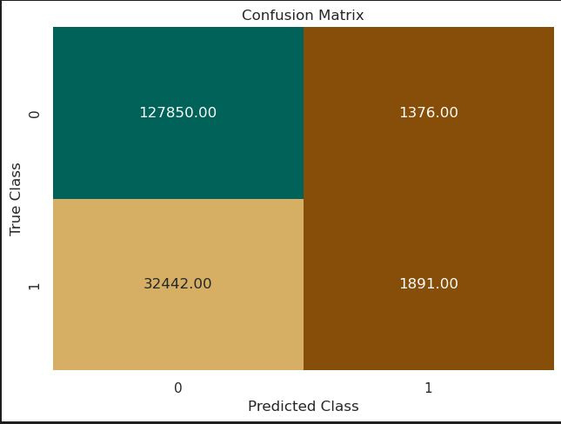
LINEARLEARNER TRAIN CONFUSION MATRIX

Slide 8

XGBOOST CONFUSION MATRIX

Slide 9
HYPERPARAMETER OPTIMIZATION (HPO)
Define hyperparameter ranges.
Use SageMaker’s HyperparameterTuner to find the best parameters.
Evaluate the best model.
Evaluating the Best Model by :
1-Retrieve the best training job.
2-Fit the best estimator on the training data.
3-Perform batch transformation to get predictions.

Slide 10
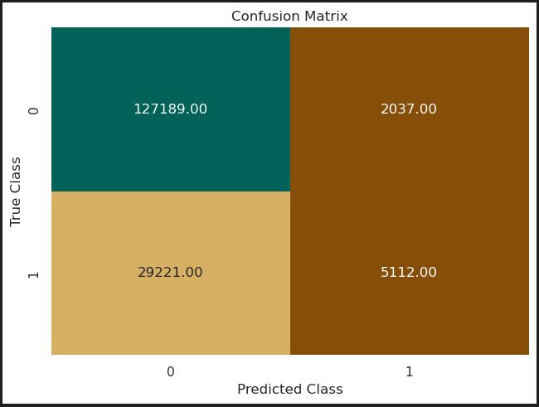
HYPERPARAMETER TUNING RESULTS ON XGBOOST

Slide 11


THANK YOU

